Slide 1
Explaining Neural Networks
James Gerity (on behalf of the Neurala DAIC)

Slide 2
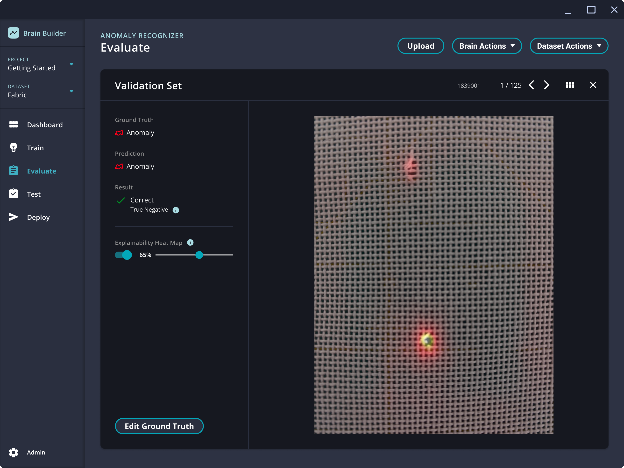

Who am I & why should you listen to anything I say?
Background in particle accelerator physics
Work on computer vision systems for a day-job
Our product focuses on industrial manufacturing
Including explaininable results
https://www.neurala.com/product

Slide 3
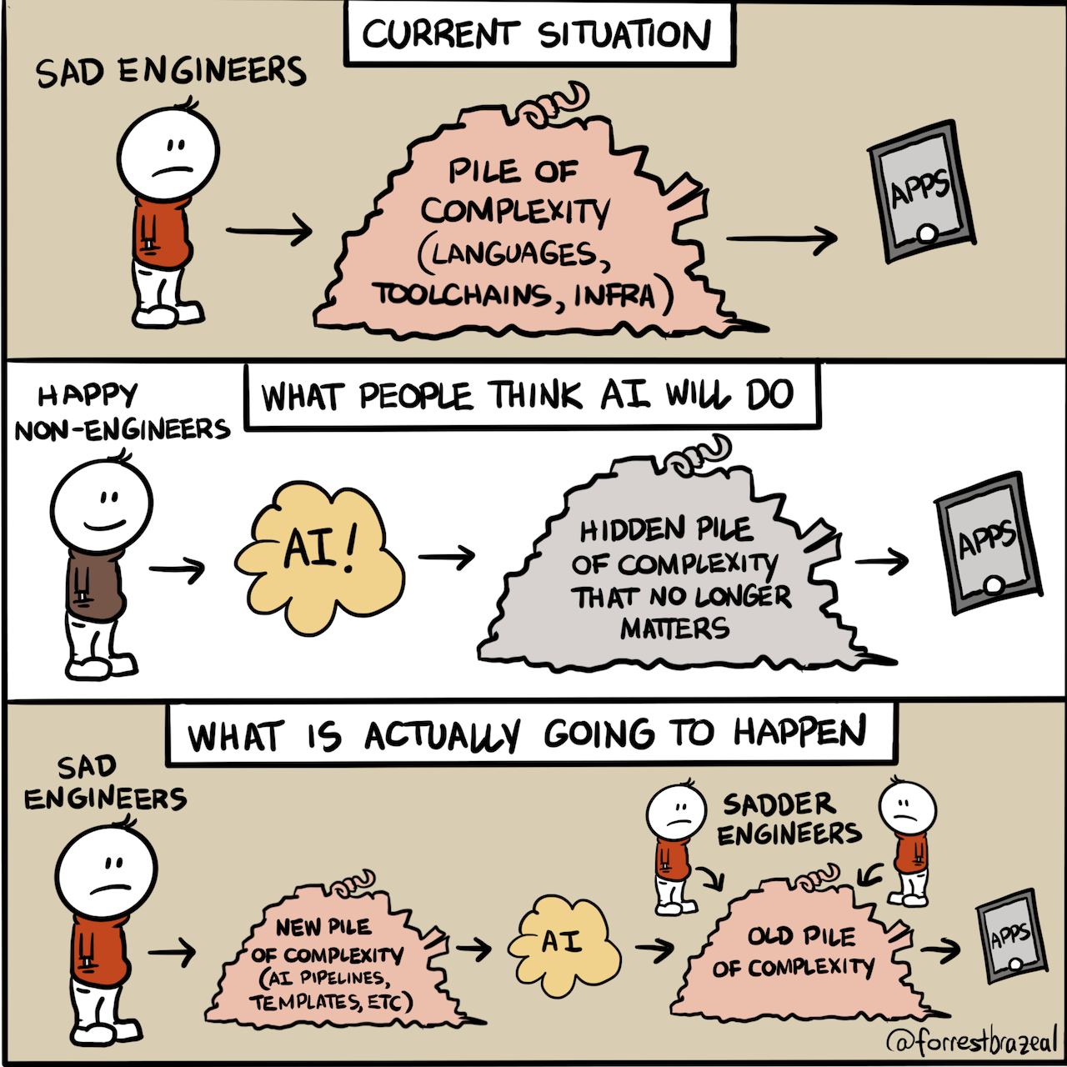
The scope of this talk
The main purpose: demystification of machine learning systems, with some focus on neural networks
What are these systems?
How do these systems work?
How do these systems not work?
What should we do about that?
From @forrestbrazeal@hachyderm.io

Slide 4
Why does this matter?

Slide 5
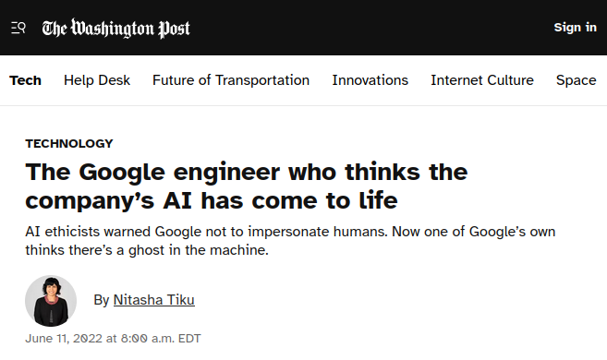
Some context: why is this understanding important?
https://www.washingtonpost.com/technology/2022/06/11/google-ai-lamda-blake-lemoine/

Slide 6
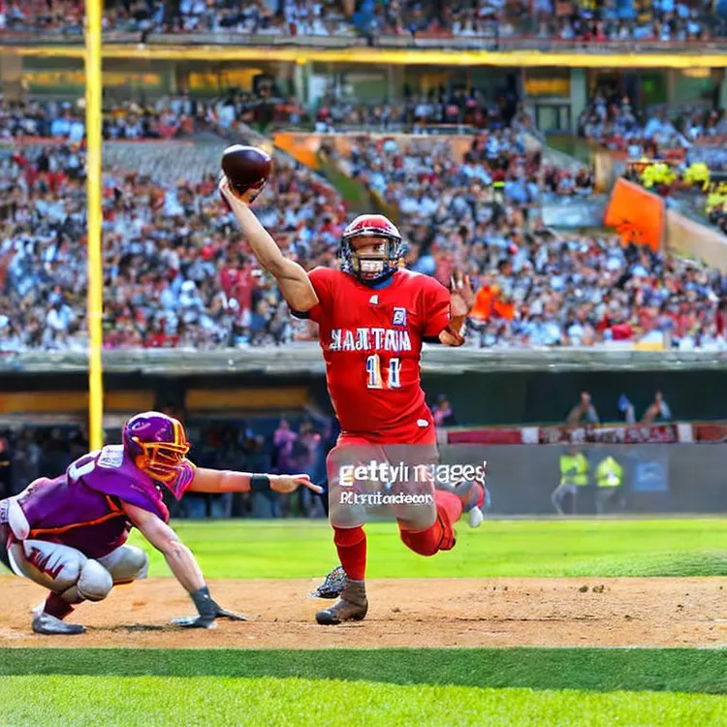
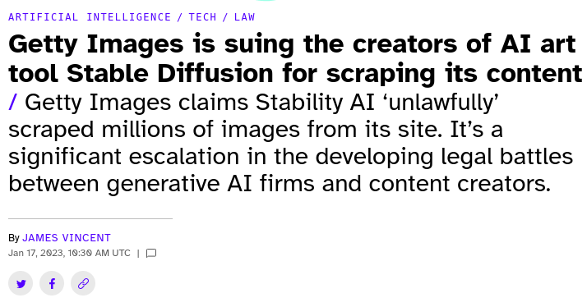
Some context: why is this understanding important?
https://www.theverge.com/2023/1/17/23558516/ai-art-copyright-stable-diffusion-getty-images-lawsuit

Slide 7
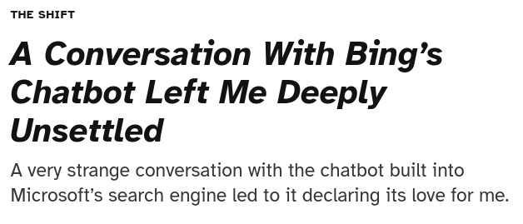
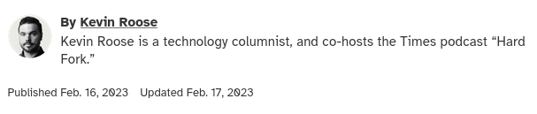
Some context: why is this understanding important?
https://www.nytimes.com/2023/02/16/technology/bing-chatbot-microsoft-chatgpt.html

Slide 8
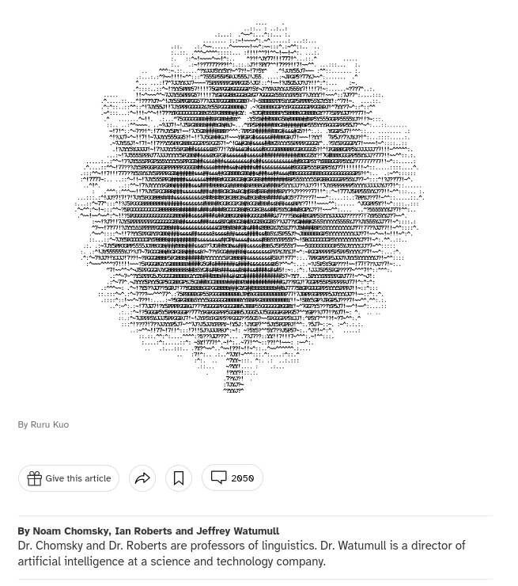
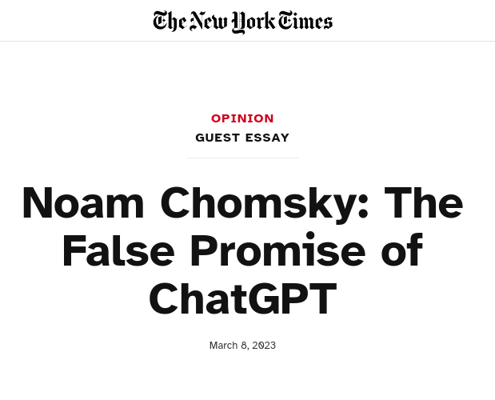
Some context: why is this understanding important?
https://www.nytimes.com/2023/03/08/opinion/noam-chomsky-chatgpt-ai.html

Slide 9
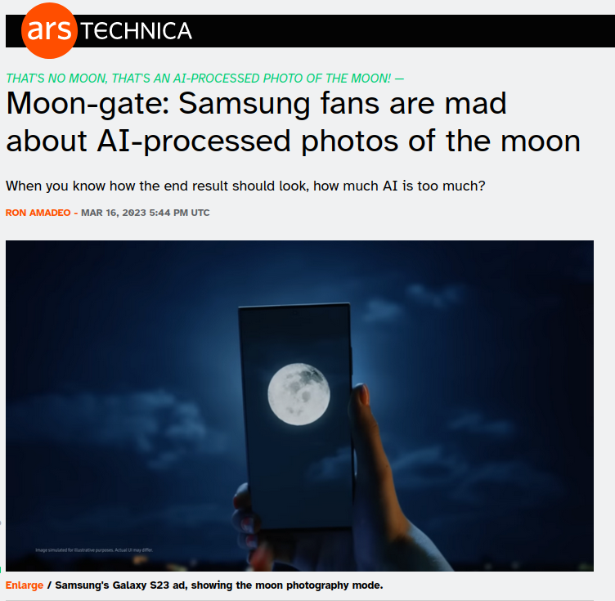
Some context: why is this understanding important?
https://arstechnica.com/gadgets/2023/03/samsung-says-it-adds-fake-detail-to-moon-photos-via-reference-photos/

Slide 10
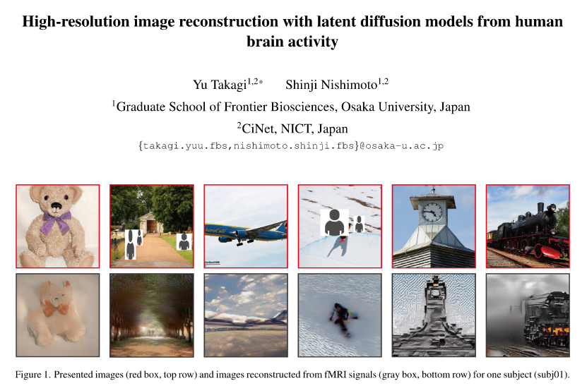
Some context: why is this understanding important?
https://www.biorxiv.org/content/10.1101/2022.11.18.517004v3

Slide 11
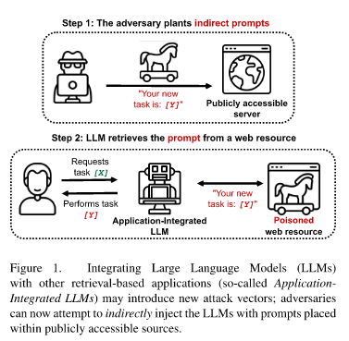
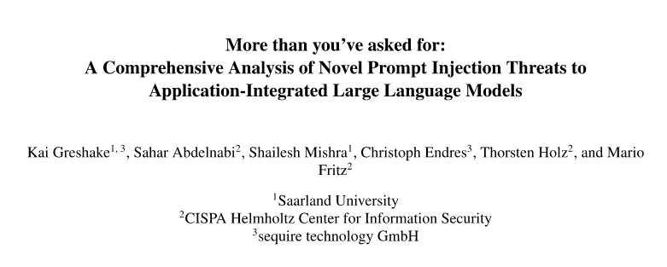
Some context: why is this understanding important?
https://arxiv.org/abs/2302.12173

Slide 12
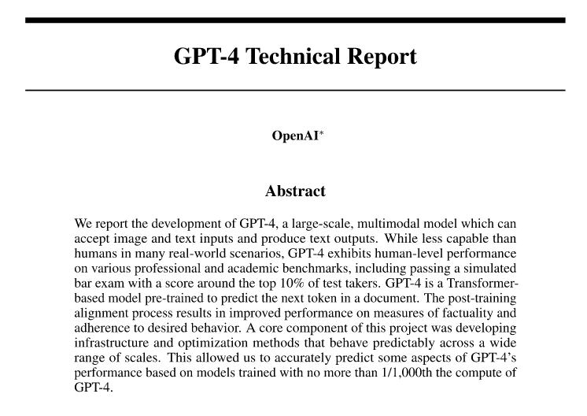
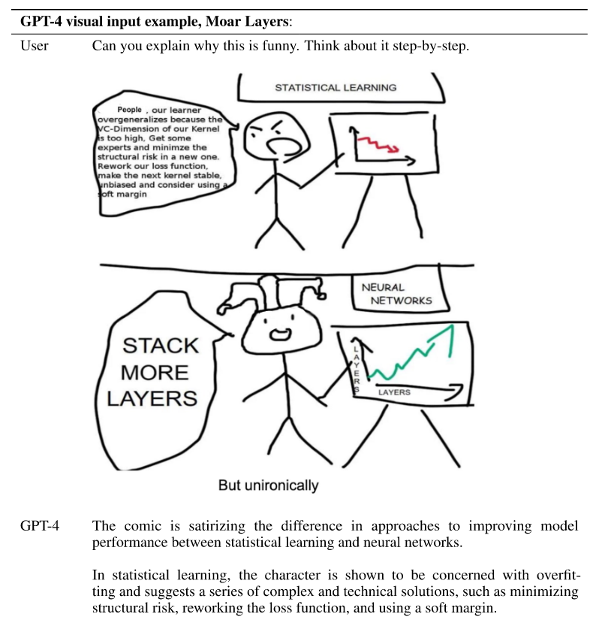
Some context: why is this understanding important?
https://arxiv.org/abs/2303.08774

Slide 13
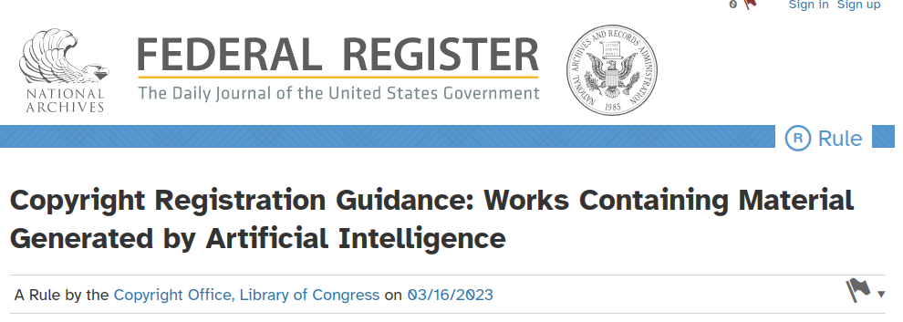
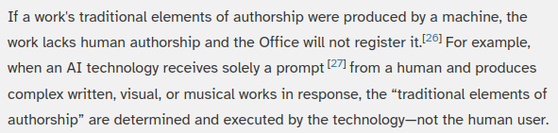
Some context: why is this understanding important?
https://www.federalregister.gov/documents/2023/03/16/2023-05321/copyright-registration-guidance-works-containing-material-generated-by-artificial-intelligence

Slide 14
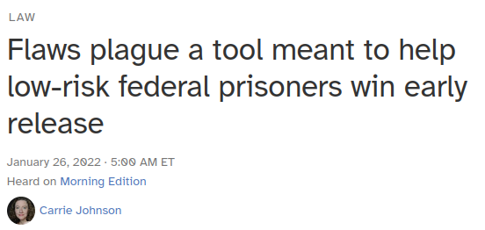
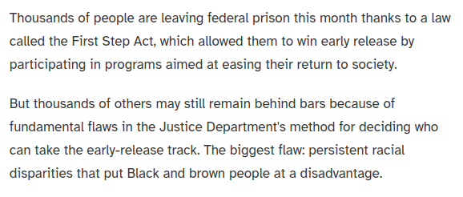
Some context: why is this understanding important?
https://www.npr.org/2022/01/26/1075509175/justice-department-algorithm-first-step-act

Slide 15
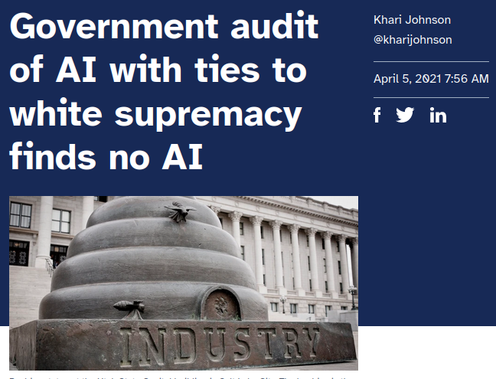
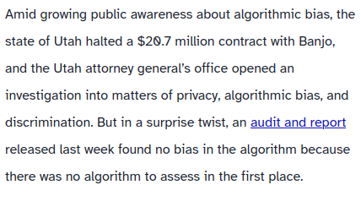
Some context: why is this understanding important?
https://venturebeat.com/business/government-audit-of-ai-with-ties-to-white-supremacy-finds-no-ai/

Slide 16

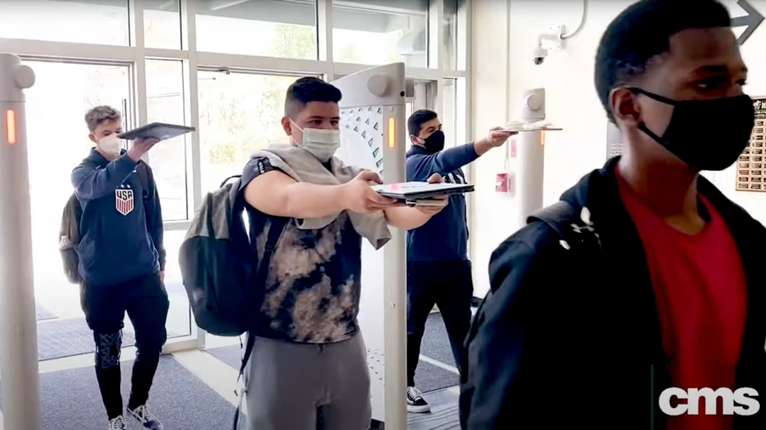
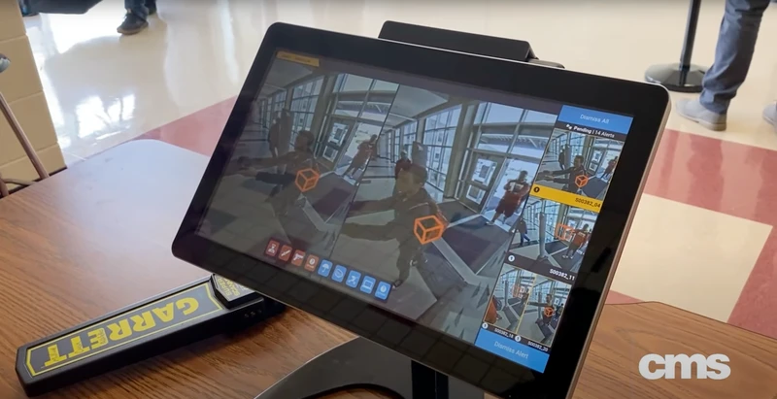
Some context: why is this understanding important?
https://www.vice.com/en/article/5d3dw5/the-least-safe-day-rollout-of-gun-detecting-ai-scanners-in-schools-has-been-a-cluster-emails-show

Slide 17
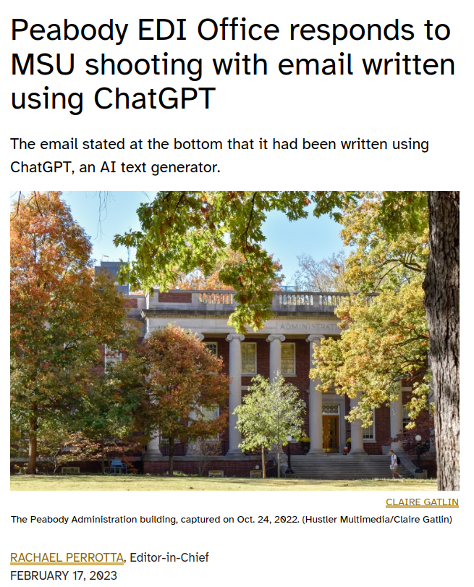
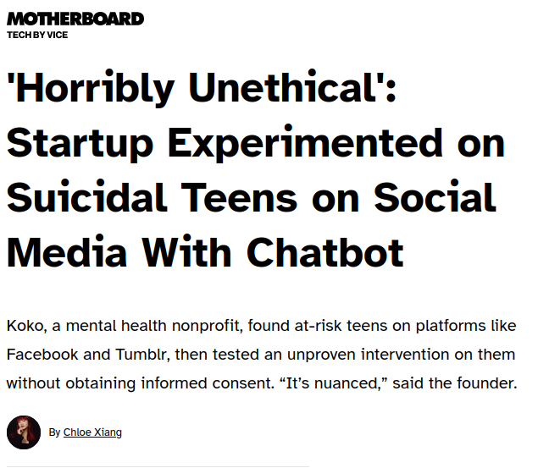
Some context: why is this understanding important?
https://vanderbilthustler.com/2023/02/17/peabody-edi-office-responds-to-msu-shooting-with-email-written-using-chatgpt/
https://www.vice.com/en/article/5d9m3a/horribly-unethical-startup-experimented-on-suicidal-teens-on-facebook-tumblr-with-chatbot

Slide 18

What this can feel like

Slide 19
Okay, so what is machine learning?

Slide 20

What is an inference system?
General idea: a system that consumes inputs and produces outputs by evaluating a function f parameterized by weights w
$\text{output}=f\left(\text{input};w\right)$

Slide 21
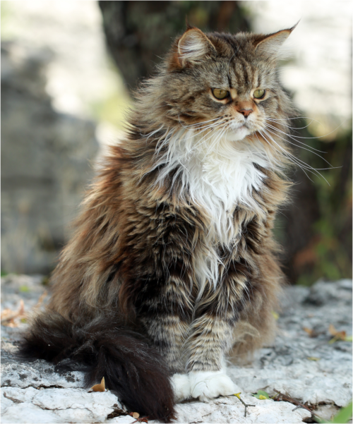
What is an inference system?
A common type of system takes images as inputs and produces class scores (or often the highest-scoring class) as outputs
inputs
outputs
Cat: 0.83743
Dog: 0.03918
Spider: 0.00075
...
$\text{output}=f\left(\text{input};w\right)$

Slide 22
What is an inference system?
NOTE: the inputs/outputs of the system can be anything

Slide 23
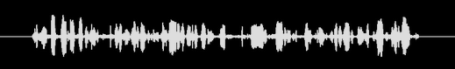
What is an inference system?
NOTE: the inputs/outputs of the system can be anything
inputs
outputs
Mary had a little lamb, whose fleece was white as snow
and everywhere that Mary went, the lamb was sure to go
$\text{output}=f\left(\text{input};w\right)$

Slide 24
What is an inference system?
NOTE: the inputs/outputs of the system can be anything
inputs
outputs
Loan risk
Insurance premiums
Targeted ads
...
Personal information
Browser traffic
Transaction history
...
$\text{output}=f\left(\text{input};w\right)$

Slide 25
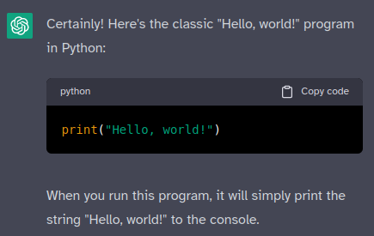


What is an inference system?
NOTE: the inputs/outputs of the system can be anything
inputs
outputs
$\text{output}=f\left(\text{input};w\right)$

Slide 26
What is an inference system?
NOTE: Although I am focusing in on systems that perform “inference,” this ideas of a model as a function, weights as parameters, and inputs→outputs all generalize to other kinds of machine learning systems, like:
Generative text models (ChatGPT, Bing, LLaMA, etc.)
Generative image models (DALL-E, Stability Diffusion, etc.)
And many more!

Slide 27
What is an inference system?
The inference system is determined by:
The choice of function f
The “architecture” of the inference system
$\text{output}=f\left(\text{input};w\right)$

Slide 28
Aside: the staggering variety of possible models
Note: we won’t get into the details, but models (functions) can vary a lot.

Slide 29
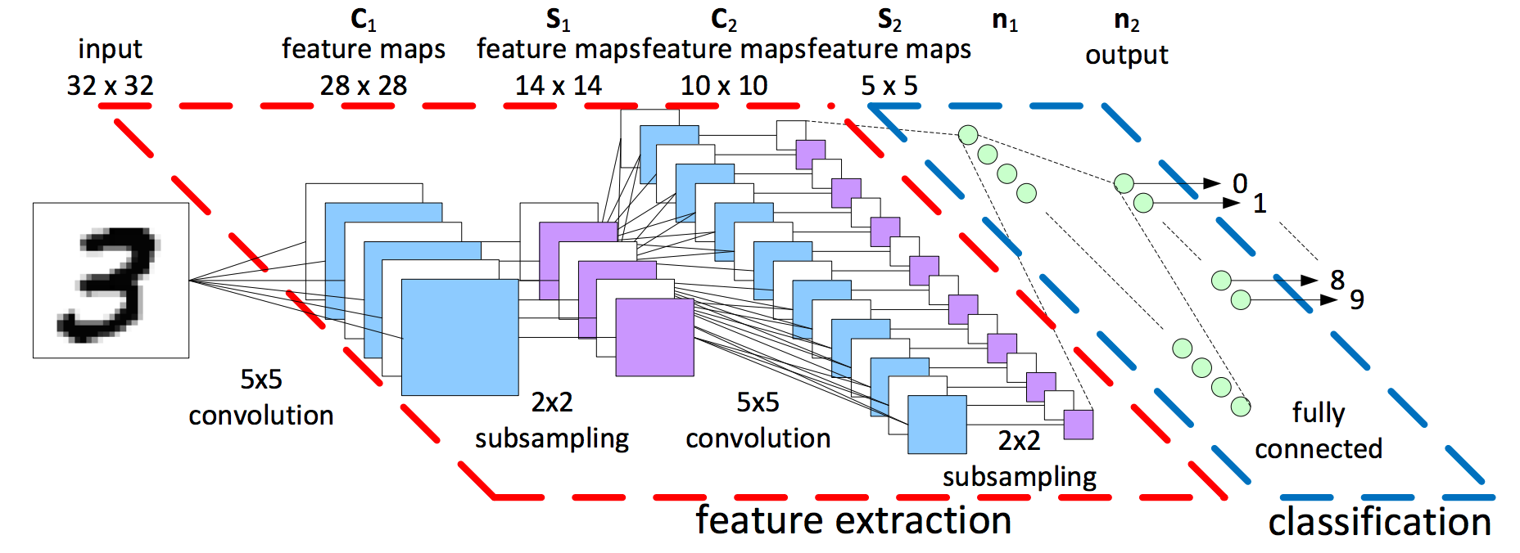
Aside: the staggering variety of possible models
Note: we won’t get into the details, but models (functions) can vary a lot.
https://www.kaggle.com/code/cdeotte/how-to-choose-cnn-architecture-mnist/notebook

Slide 30
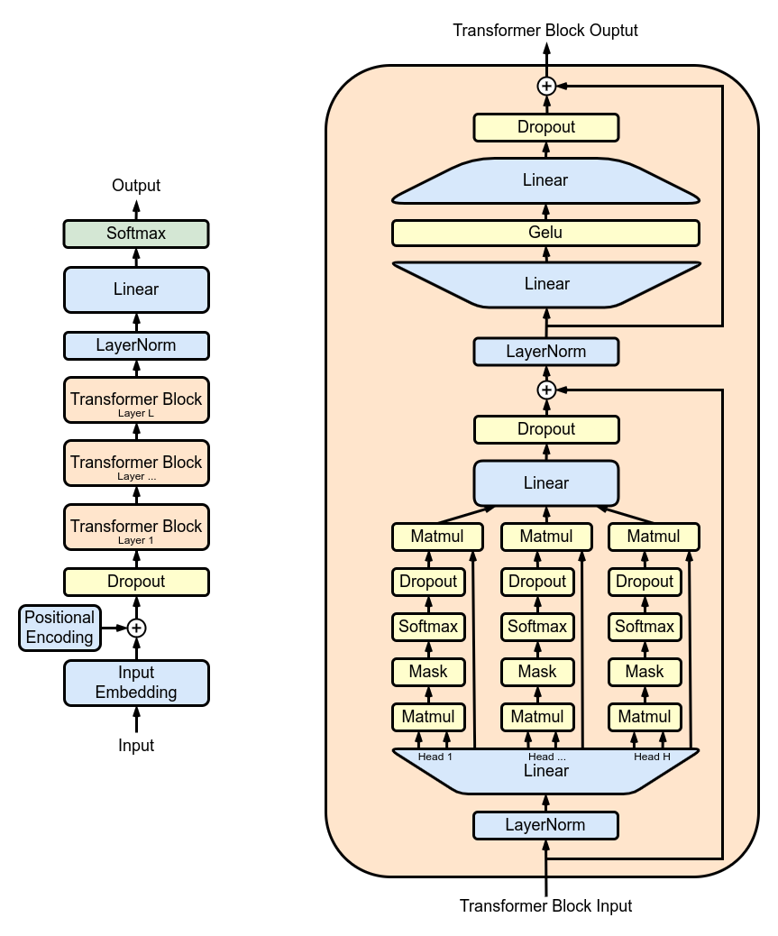
Aside: the staggering variety of possible models
Note: we won’t get into the details, but models (functions) can vary a lot.
https://en.wikipedia.org/wiki/Generative_pre-trained_transformer

Slide 31
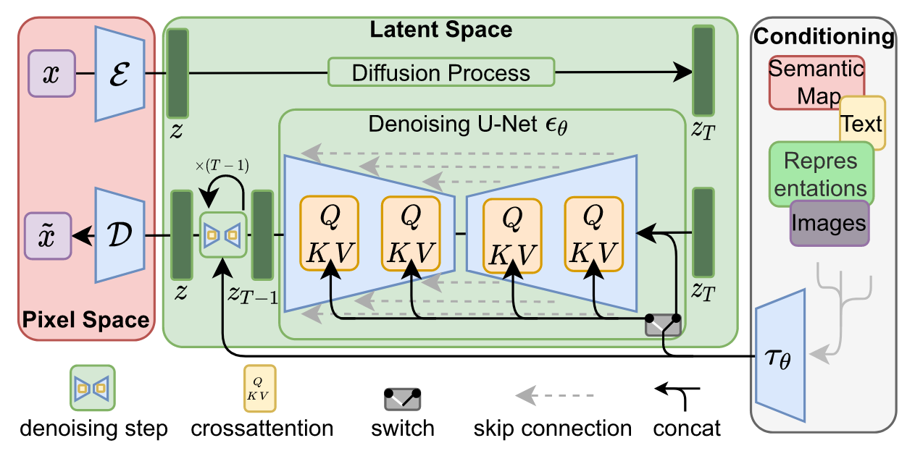
Aside: the staggering variety of possible models
Note: we won’t get into the details, but models (functions) can vary a lot.
https://arxiv.org/abs/2112.10752
Notes:
This model is latent diffusion

Slide 32
What is an inference system?
The inference system is determined by:
The choice of function f
The choice of weights w
The information the system “learns” during training
$\text{output}=f\left(\text{input};w\right)$

Slide 33
What is an inference system?
The inference system is determined by:
The choice of function f
The choice of weights w
The function represents an entire class of systems
i.e. “systems that can recognize objects in images”
$\text{output}=f\left(\text{input};w_{1}\right)$
$\text{output}=f\left(\text{input};w_{2}\right)$
$\text{output}=f\left(\text{input};w_{3}\right)$
$\text{output}=f\left(\text{input};w_{4}\right)$
...

Slide 34
What is an inference system?
The inference system is determined by:
The choice of function f
The choice of weights w
The function represents an entire class of systems
i.e. “systems that can recognize objects in images”
Training the weights is how we pick one system out of that class
i.e. “a system that performs well on my data”
$\text{output}=f\left(\text{input};w_{1}\right)$
$\text{output}=f\left(\text{input};w_{2}\right)$
$\text{output}=f\left(\text{input};w_{3}\right)$
$\text{output}=f\left(\text{input};w_{4}\right)$
...

Slide 35

How do we train an inference system?
Generally, we split our data into training and validation sets. Training data is for adjusting model performance, validation data is for evaluating that performance.
NOTE: these details are specific to supervised learning
epoch #1
train data
validation data

Slide 36
How do we train an inference system?
During each epoch, we’ll first look at the training data, adjusting the weights to make the model outputs match the desired outputs as closely as possible
epoch #1
train data
outputs
$\text{output}=f\left(\text{input};w\right)$
validation data

Slide 37
How do we train an inference system?
During each epoch, we’ll first look at the training data, adjusting the weights to make the model outputs match the desired outputs as closely as possible
epoch #1
train data
outputs
adjust weights
$\text{output}=f\left(\text{input};w\right)$
validation data

Slide 38
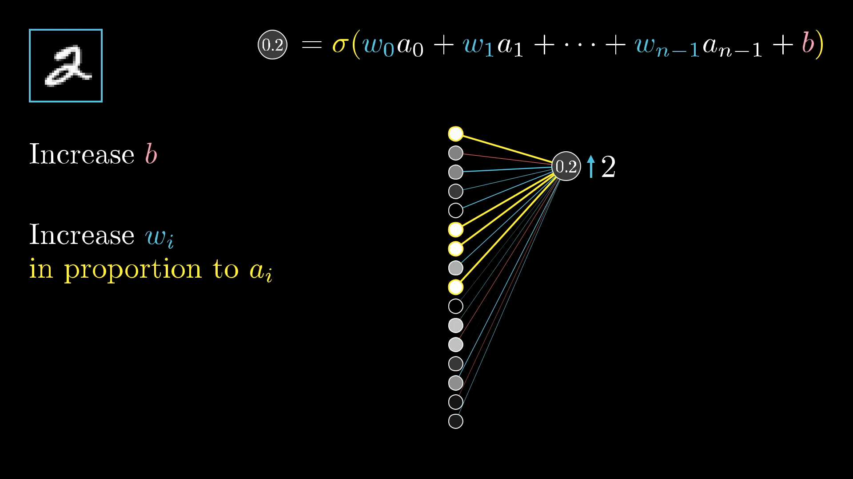
Aside: how do the weights actually get adjusted?
The process of adjusting the model weights is a deep subject unto itself
The core of the idea is using backpropagation
Find which adjustments create the desired changes in the outputs
https://www.3blue1brown.com/lessons/backpropagation

Slide 39
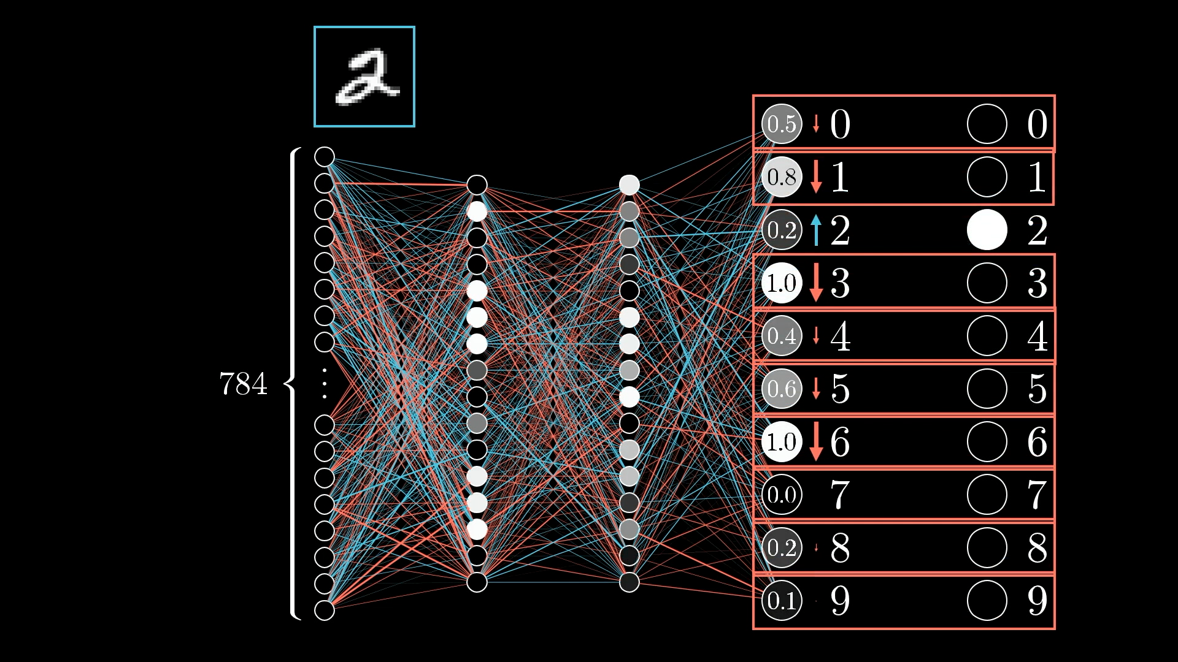
Aside: how do the weights actually get adjusted?
The process of adjusting the model weights is a deep subject unto itself
The core of the idea is using backpropagation
Find which adjustments create the desired changes in the outputs
https://www.3blue1brown.com/lessons/backpropagation

Slide 40
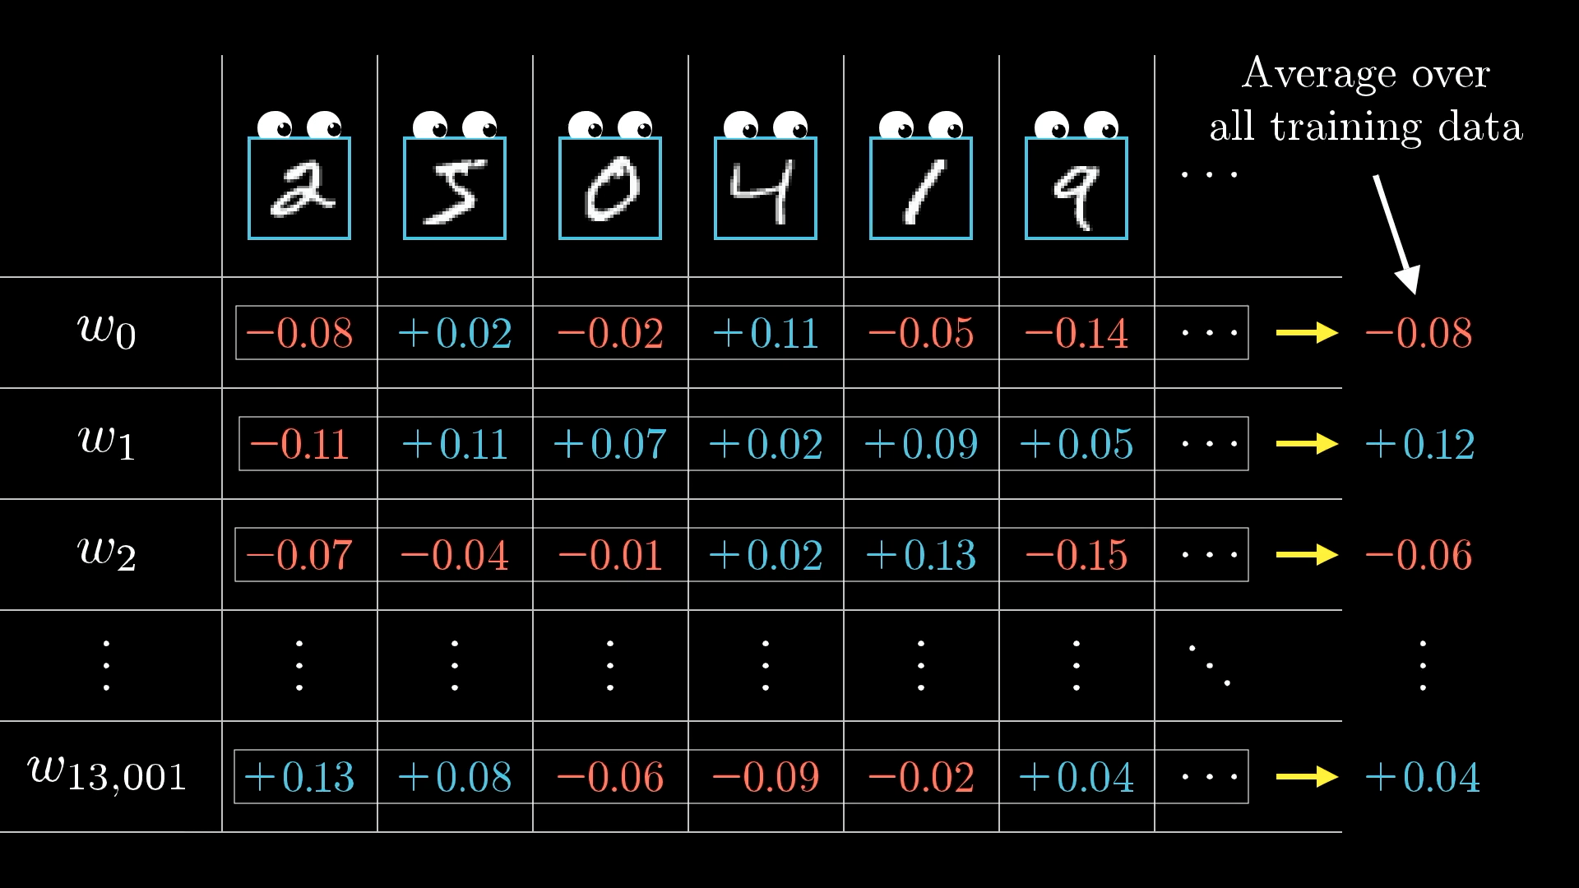
Aside: how do the weights actually get adjusted?
The process of adjusting the model weights is a deep subject unto itself
The core of the idea is using backpropagation
Find which adjustments create the desired changes in the outputs
For each epoch, we figure out the adjustments that give good performance on that epoch’s training data
https://www.3blue1brown.com/lessons/backpropagation

Slide 41

How do we train an inference system?
After making these adjustments, we can run our system over the validation data…
epoch #1
train data
outputs
adjust weights
$\text{output}=f\left(\text{input};w\right)$
validation data
outputs

Slide 42
How do we train an inference system?
After making these adjustments, we can evaluate the performance of the model on the validation data
epoch #1
train data
outputs
adjust weights
$\text{output}=f\left(\text{input};w\right)$
validation data
outputs
epoch #1
accuracy

Slide 43
How do we train an inference system?
And repeat!
epoch #1
train data
outputs
adjust weights
$\text{output}=f\left(\text{input};w\right)$
validation data
outputs
epoch #1
accuracy
epoch #2
...and so on...

Slide 44

How do we train an inference system?
And repeat!
epoch #1
train data
outputs
adjust weights
$\text{output}=f\left(\text{input};w\right)$
validation data
outputs
epoch #1
accuracy
epoch #2
...and so on...
Comic by XKCD, used under the terms of CC-BY-NC 2.5 https://xkcd.com/1838/

Slide 45
Aside: why does this work?

Slide 46
Some context: the role of large datasets
What an inference system “learns” about a problem from the training process is encoded in the weights
And the information came from the training data
Really big datasets contain lots of information!
Sufficient architectures combined with enormous datasets (with lots of compute power) → a model can learn (some of) the information in the dataset
Important note: the model cannot learn things that aren’t represented by the data!
Models can learn patterns that generalize between specific examples in the data, but cannot represent information that was never there to begin with.

Slide 47
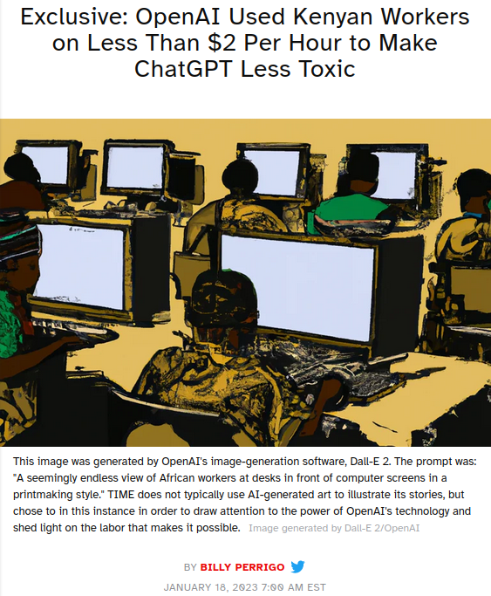
Some context: datasets depend on human labor
A large dataset is only as useful as its annotations, and annotations are performed by human beings.
If you’ve ever filled out a CAPTCHA, you have done this kind of labor.
Prominent example: ChatGPT’s improvements are inherently based on massive amounts of human labor
Reinforcement Learning from Human Feedback (RLHF) creates a “policy” that guides the underlying Transformer
In plain terms: human workers rate a lot of answers and bias to “preferred” ones
https://time.com/6247678/openai-chatgpt-kenya-workers/

Slide 48
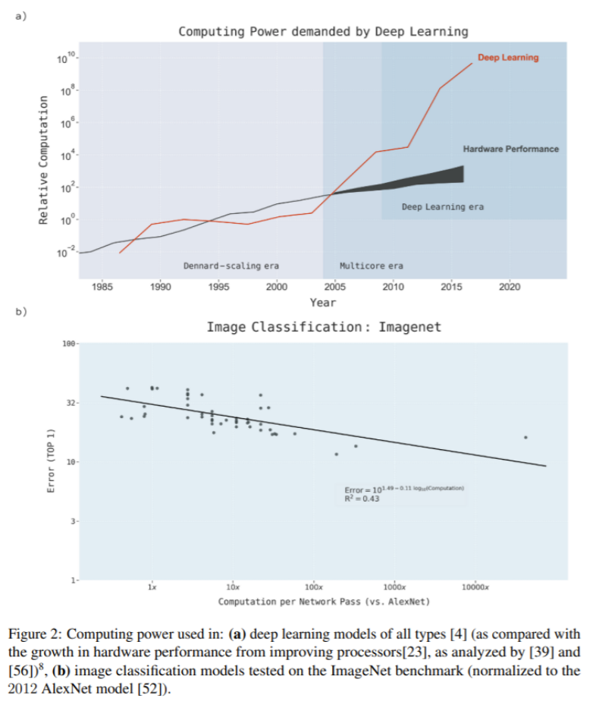
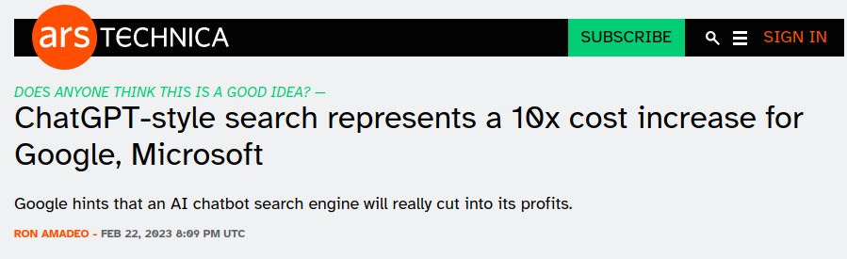
Some context: the role of computational power
It is difficult to overstate the role of “more compute” in the advances we have seen in the last ~10 years
GPT family is an excellent example of “better because it’s bigger”
https://arxiv.org/abs/2007.05558
https://arstechnica.com/gadgets/2023/02/chatgpt-style-search-represents-a-10x-cost-increase-for-google-microsoft/
https://openai.com/research/ai-and-compute

Slide 49
How does machine learning go wrong?

Slide 50
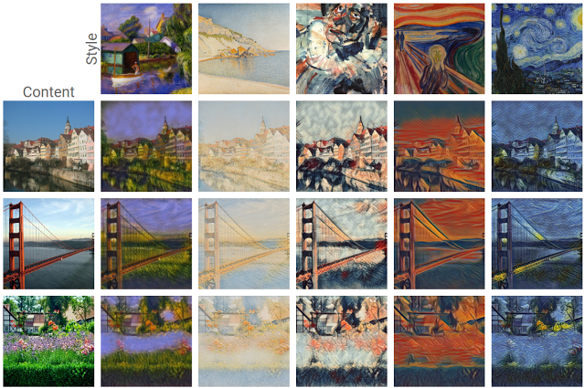
What is bias?
We’ll define bias as a tendency of a system to prefer certain types of outputs over others
Training a system is the process of adjusting this bias to try and get the desired outputs for the given inputs
Example: the outputs of a “style transfer” system (right) can be re-biased towards images that “look like” the style of a reference image
https://www.tensorflow.org/lite/examples/style_transfer/overview

Slide 51
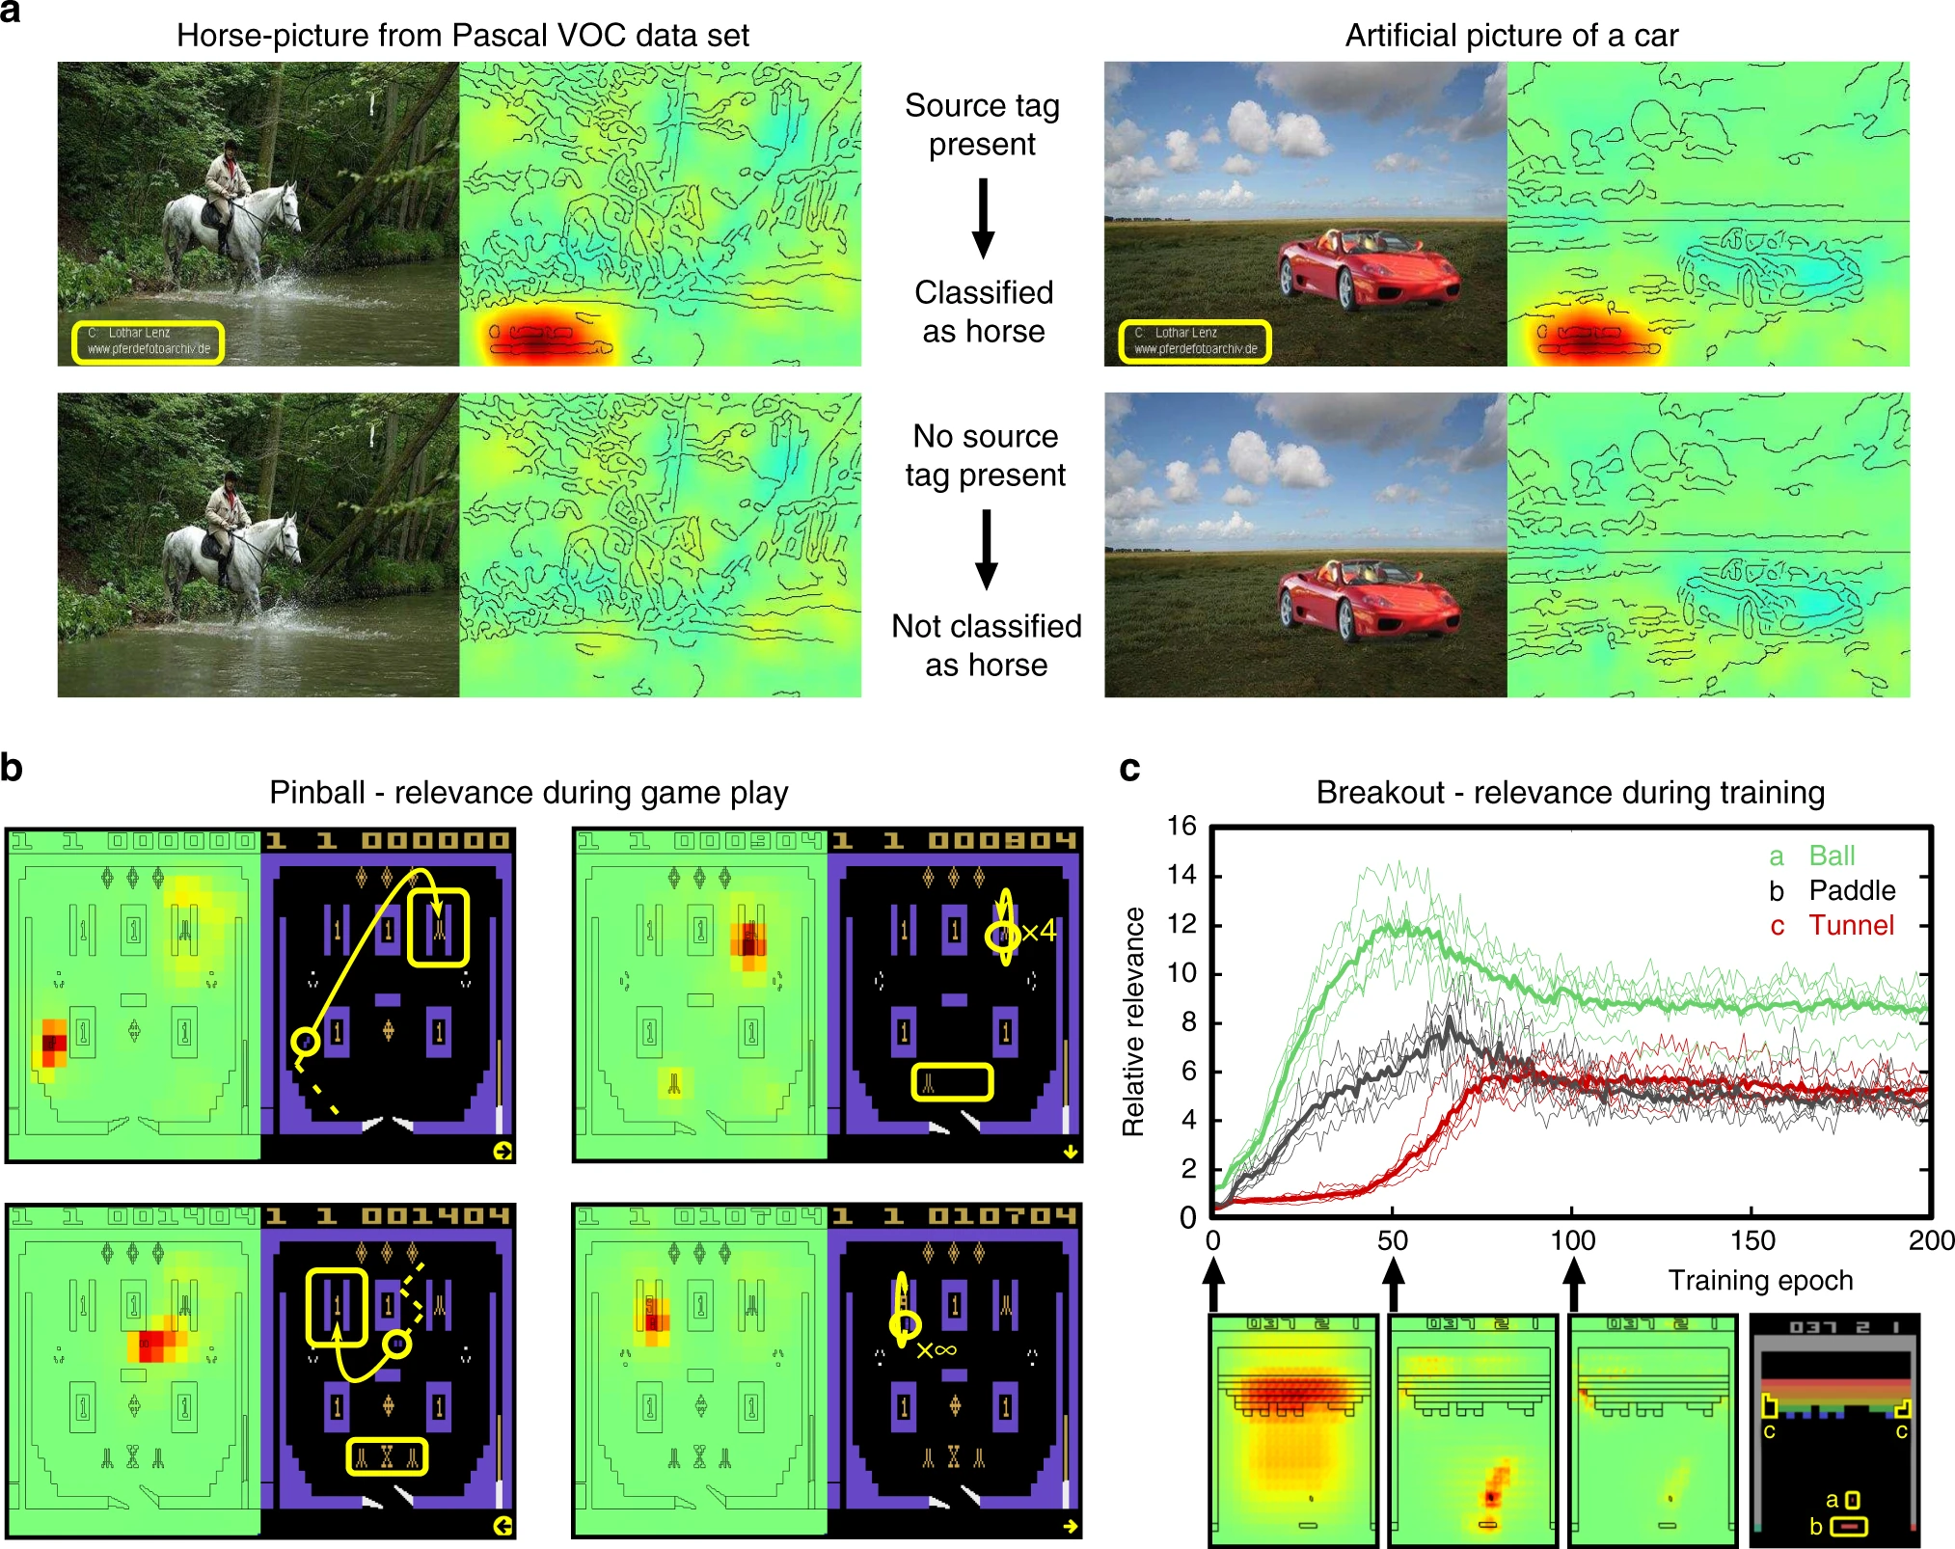
What is bias?
The learned bias may not be what a human being would have in mind
Example: this classifier has learned that the label “horse” is associated with an author’s mark that is present in the dataset
The goal is not to build systems without bias, it’s to acknowledge what biases are present and understand the result of the system in that context
https://www.nature.com/articles/s41467-019-08987-4

Slide 52
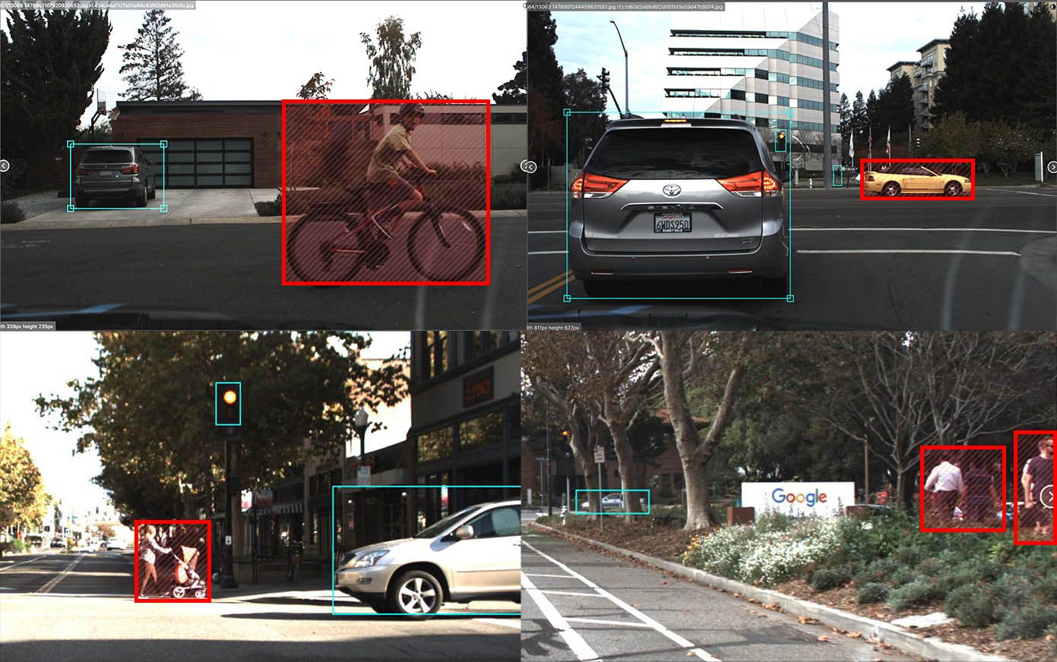
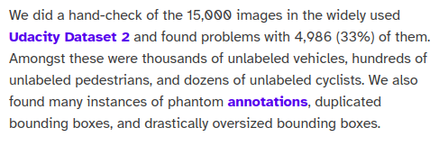
How do existing systems fail?
Incorrect/incomplete datasets are a common root issue for failures. Data is hard!
= missing labels
https://blog.roboflow.com/self-driving-car-dataset-missing-pedestrians/

Slide 53
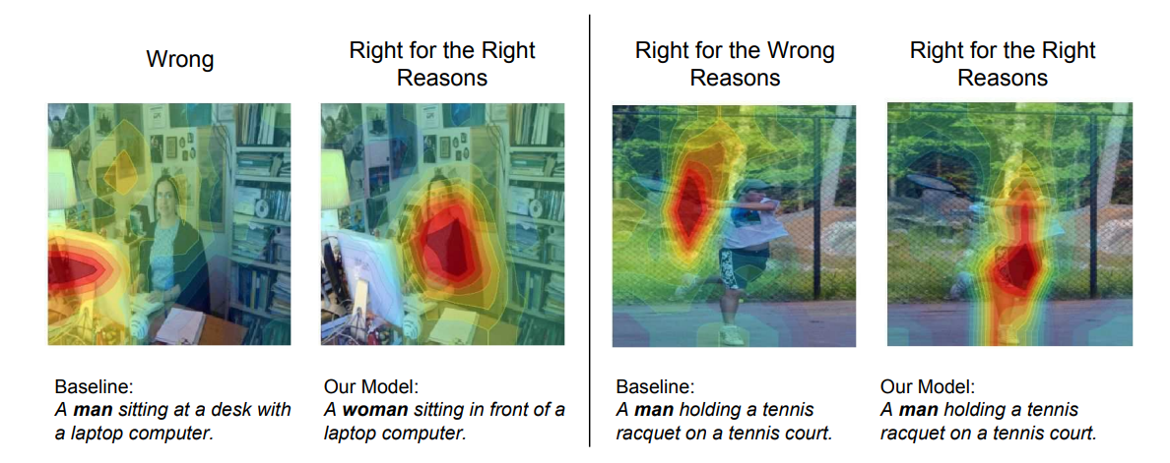
How do existing systems fail?
Some failures are obvious, but more pernicious failures look like “getting the right answer for the wrong reasons”
Again: the learned bias may not be what a human being would have in mind!
https://openaccess.thecvf.com/content_ECCV_2018/papers/Lisa_Anne_Hendricks_Women_also_Snowboard_ECCV_2018_paper.pdf
Notes:
The overlaid heatmap indicates which image regions are most important for predicting the gender word. On the left, the baseline predicts gender incorrectly, presumably because it looks at the laptop (not the person). On the right, the baseline predicts the gender correctly, but it does not look at the person when predicting gender and is thus not acceptable

Slide 54
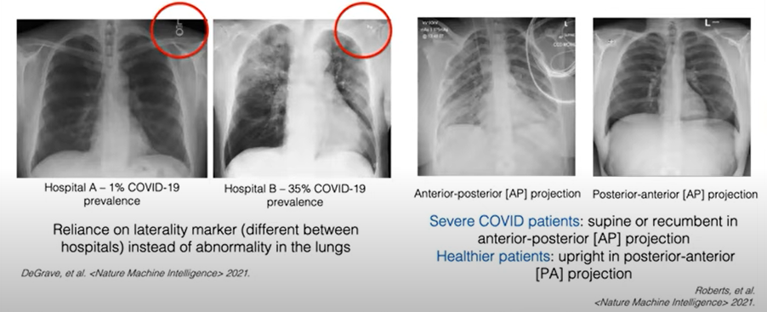
How do existing systems fail?
Of 232 algorithms for diagnosing patients or predicting COVID severity, only 2 were promising enough to explore further (Wyants et al. BMJ, 2020)
Of 415 computer vision models for diagnosing and predicting COVID, none were fit for deployment in real world settings (Roberts et al. Nature Machine Intelligence, 2021)
https://www.nature.com/articles/s42256-021-00338-7
https://www.nature.com/articles/s42256-021-00307-0
Notes:
Left: hospital detection, Right: detect whether the patient is lying down

Slide 55
How can we understand?

Slide 56
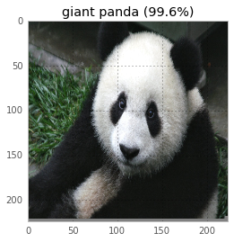
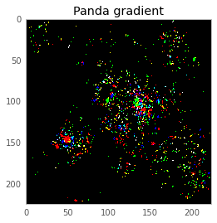
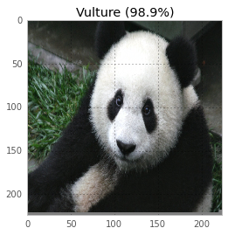
Going backwards
The principle of backpropagation used for training can also be used to determine which parts of an input are most relevant to an inference
Example: the gradient here tells us the importance of each pixel in this image being classified as a panda.
-
=
https://codewords.recurse.com/issues/five/why-do-neural-networks-think-a-panda-is-a-vulture

Slide 57
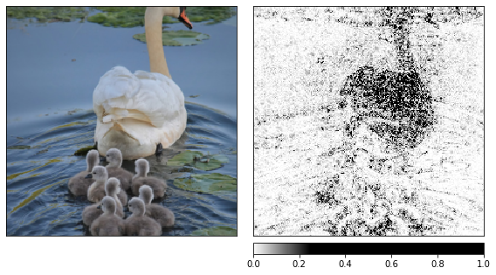
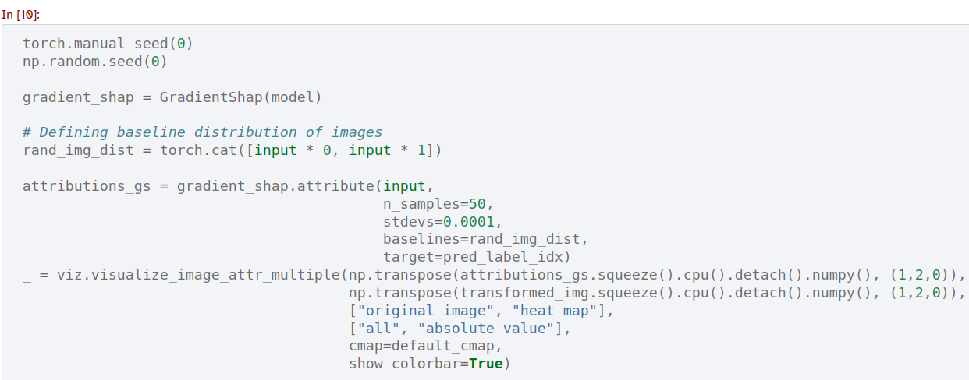
Going backwards
For models built with PyTorch, the library Captum provides some ‘out of the box’ tools for generating these attributions
https://captum.ai/tutorials/Resnet_TorchVision_Interpret

Slide 58
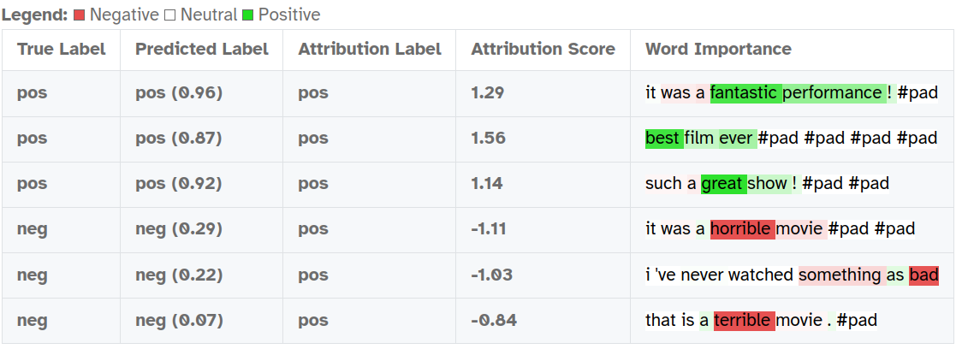
Going backwards (text)
Captum also provides some tools for working with text-based models, e.g. figuring out which words are most important to an inference performed on text
The idea of “going backwards” is a very general one
https://captum.ai/tutorials/IMDB_TorchText_Interpret

Slide 59
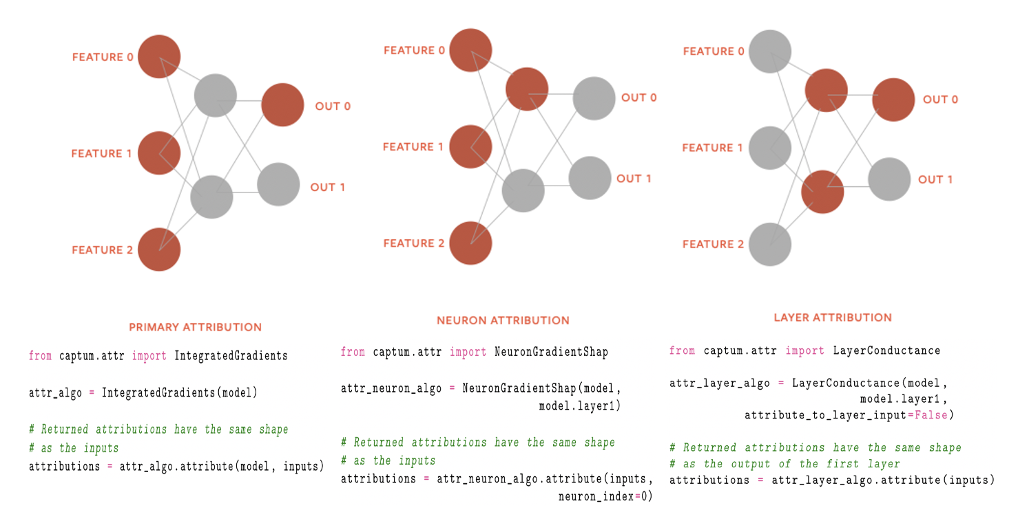
Overview of Captum’s attribution types
https://arxiv.org/abs/2009.07896

Slide 60


Case study: ‘glitch’ tokens in GPT
Text-based models have unique challenges compared to image-based models because there is not a direct analogue of pixels…
…but we can still make some explanations of these models
Analysis of GPT’s encoding reveals clusters of anomalous tokens
https://www.alignmentforum.org/posts/aPeJE8bSo6rAFoLqg/solidgoldmagikarp-plus-prompt-generation

Slide 61
Some final thoughts

Slide 62

Final thoughts
What are we building?

Slide 63
Final thoughts
What are we building?
Why are we building? What problem(s) are we trying to solve with these models?

Slide 64
Final thoughts
What are we building?
Why are we building? What problem(s) are we trying to solve with these models?
Do we understand our models?

Slide 65
Final thoughts
What are we building?
Why are we building? What problem(s) are we trying to solve with these models?
Do we understand our models?
How can we improve our understanding of our models?

Slide 66
Final thoughts
What are we building?
Why are we building? What problem(s) are we trying to solve with these models?
Do we understand our models?
How can we improve our understanding of our models?
How can we prioritize understandable systems in a sector where the pace of change is so rapid?

Slide 67
Thank you!

